Slide 1
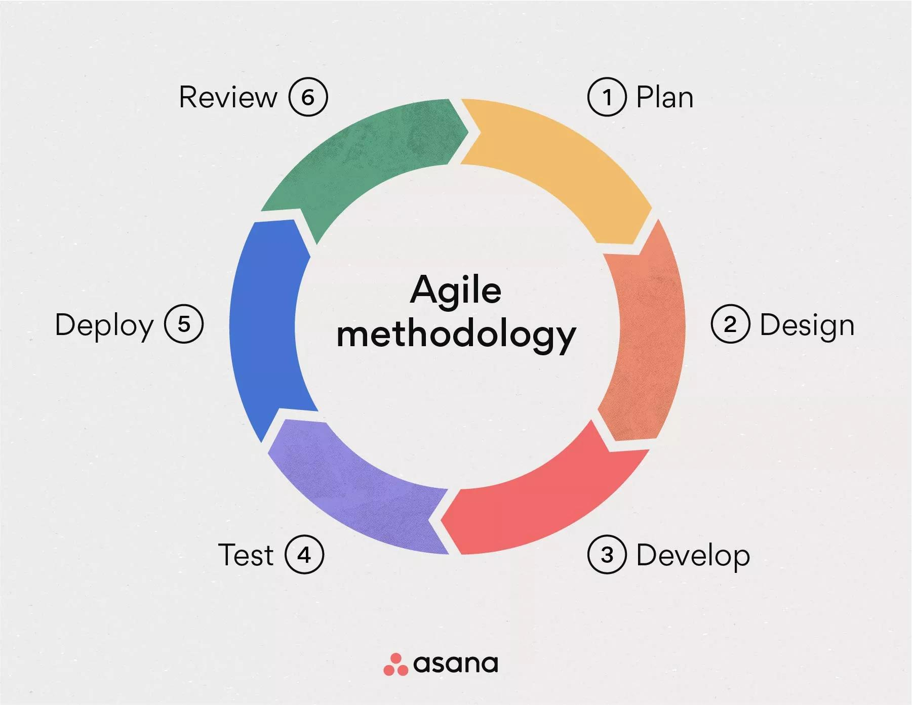
All About Agile
By: Mike R. Montminy

Slide 2
Agile Roles
Product Owner
Scrum Master
Developer Team
Tester Team

Slide 3

Scrum Master
Acts as a coach
Remove obstacles
Ensure constant progress
Organize retrospectives
Strive for high-quality work

Slide 4
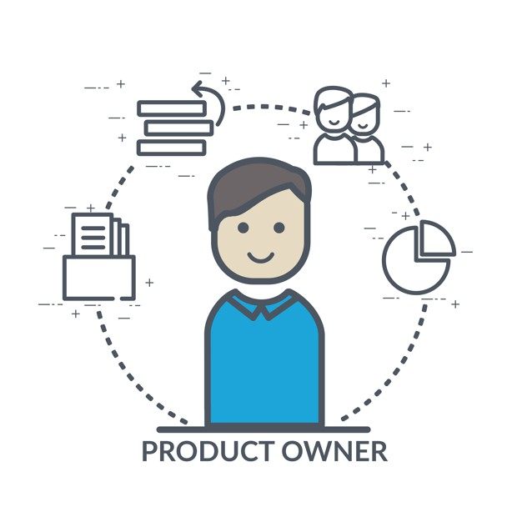
Product Owner
Align with business goals
Manage backlog
Communicate with shareholders
Maximize return value
Define product vision

Slide 5

Developer Team
Deliver shippable versions
Meet tech/quality standards
High creativity
Adapt to requirement changes
Includes designers, testers, and devs

Slide 6

Tester Team
Identify issues early
Reduce the total cost
Ensure overall quality
Check for functional req.
Improve customer satisfaction
Provide constant feedback

Slide 7
Phases of Agile
Planning
Design
Development
Testing
Deployment

Slide 8

Planning Phase
Understand the project requirements
Set up goals
Create backlog
Define roles for each involved party
Organize user stories

Slide 9

Design Phase
Design system is based on user stories
Rapid prototyping
PO ensures design stays with vision
Testers review designs to ensure quality

Slide 10

Development Phase
Deliver shippable version at end of sprints
Ensure all functions are made
Reduce risk of massive errors as early as possible
Remove as many obstacles as early as possible
Constantly test every little item

Slide 11

Testing Phase
Verify all functionality
Fix issues as they appear ASAP
Review all test results and adjust if needed
Ensure newer changes don't break anything else

Slide 12

Deployment Phase
Ensure stable product version
Fix as many issues as possible
Determine release window based on overall feedback
Allow for early access user testing

Slide 13
Waterfall vs. Agile
Waterfall:
Very linear process
Rigid requirements
Harder to implement changes needed after initial designing
Delays can be detrimental both financially and mentally for everyone
Agile:
Operates in shorter sprints
Process can be all over the grid
Decently loose requirements
Easier to adjust for new changes (Backlog Management)
Delays mostly cause little issues and usually at no extra cost

Slide 14
How to choose Waterfall or Agile?
Waterfall:
Some of the earlier assignments in the course were very linear on how the progression was to be completed, had very defined requirements with little room for change, and were for the most part very simple to finish. These three requirements lead into being able to use a waterfall approach with relative ease.
Agile:
Many of the journals and coding assignments from the course could be completed in any order. The requirements were decently well stated but were easily malleable to how I wanted to progress. The journals as well were very easy to complete in any order due to it being a more personal bit of writing and not a research style paper.

Slide 15
References
Iqbal, M. (2023, February 22). How product owners can maximize value with stakeholder input. Scrum.org. https://www.scrum.org/resources/blog/how-product-owners-can-maximize-value-stakeholder-input#:~:text=The%20benefit%20of%20stakeholder%20engagement,product%20support%20and%20buy%2Din.
C. Tona, R. Juárez-Ramírez, S. Jiménez and F. Murillo-Muñoz, "Q-Story: An Ontology-Based on Quality of User Stories in Scrum. A Quantitative Assessment," 2023 11th International Conference in Software Engineering Research and Innovation (CONISOFT), León, Guanajuato, Mexico, 2023, pp. 55-64
What is a daily scrum and do scrum masters lead them? " growing scrum masters. Growing Scrum Masters. (2024b, April 26). https://www.growingscrummasters.com/learn-scrum/what-is-a-daily-scrum-and-do-scrum-masters-lead-them/
Bianchi, M., Marzi, G., & Dabic, M. (2022). Guest Editorial: Agile Beyond Software-In Search of Flexibility in a Wide Range of Innovation Projects and Industries. IEEE TRANSACTIONS ON ENGINEERING MANAGEMENT, 69(6), 3454–3458. https://doi.org/10.1109/TEM.2022.3206408

